Slide 1
Tableau Capstone Project Presentation
Vishwajeet singh
11 OCT 2020

Slide 2
Purpose of this Project
In this project, we will explore the FDI dataset and analyze it from the prospective of a business. We shall look at various sectors to determine which sector will prove most beneficial to collaborate with, for the company.

Slide 3
Foreign Direct Investment (FDI)
This Dataset based on the Foreign Direct Investment. A foreign direct investment (FDI) is an investment made by a firm or individual in one country into business interests located in another country. Generally, FDI takes place when an investor establishes foreign business operations or acquires foreign business assets in a foreign company.

Slide 4
Problem Statement
Which sector receive the maximum direct funding for a given year?
Which sector receive the minimum direct funding for a given year?
Is there a trend for direct investments for individual sectors?
In what fashion can the sectors be grouped for comparison?
Which sectors reported the highest growth in the past 5 years?

Slide 5
Problem Statement
Which sectors reported the highest decline in the past 5 years?
Which sectors reported the most variation overall?
What is the proportion of investment between sectors from the FDI perspective?
Are there any specific clusters present in the data?
Can we forecast the trend for the following year?

Slide 6
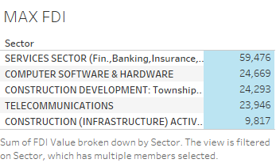
The Maximum Direct Funding Receive for a Given Year in Sectors

Slide 7
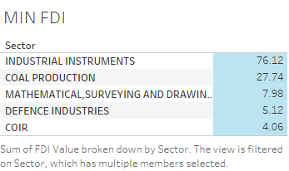
The Minimum Direct Funding Receive for a Given Year in Sectors

Slide 8
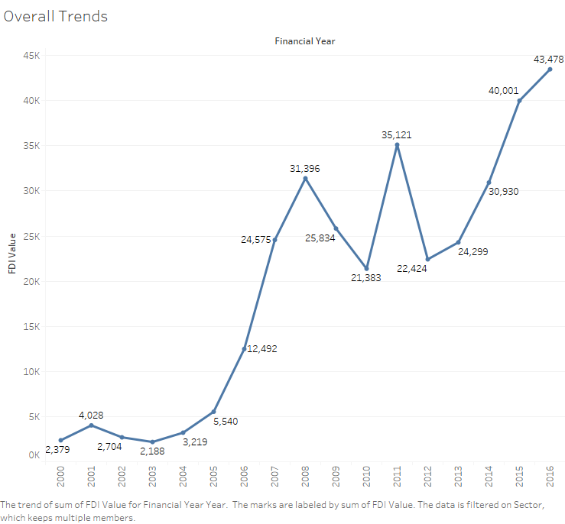
A Trend of Direct Investments for individual Sectors

Slide 9
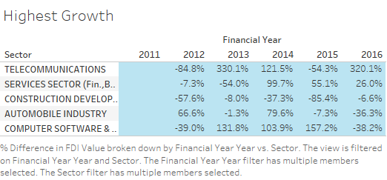
The Highest Growth in the Past 5 Years in Sectors

Slide 10
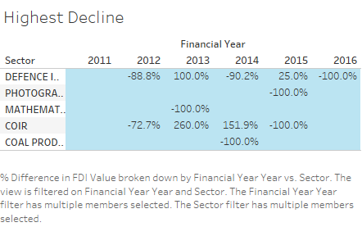
The Highest Decline in the Past 5 Years in Sectors

Slide 11
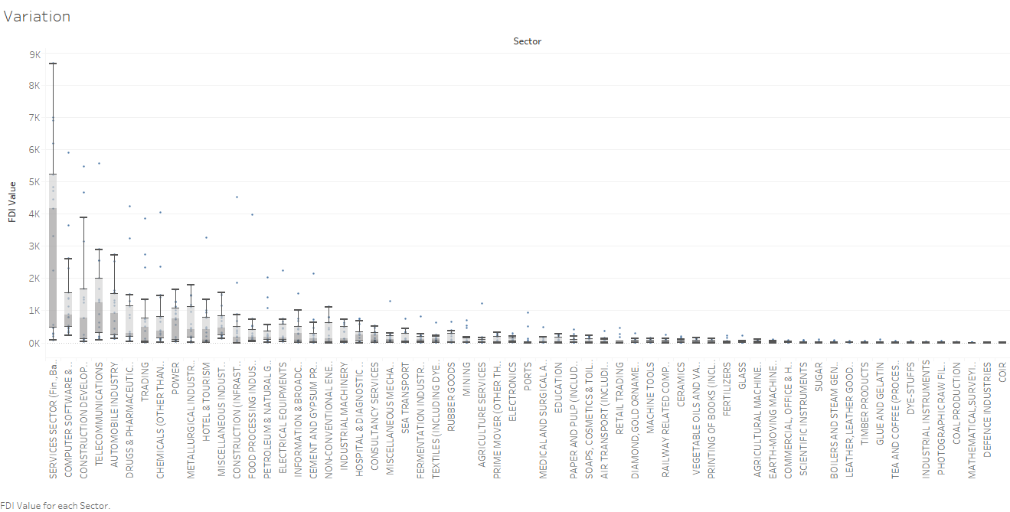
The Most Variation Overall in Sectors

Slide 12
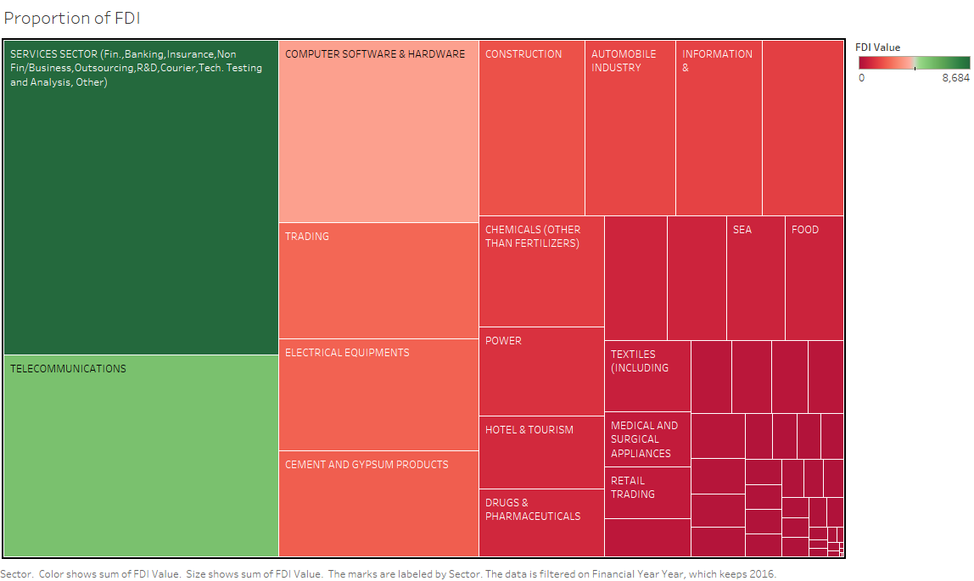
The Proportion of Investment Between Sectors From The FDI Perspective

Slide 13
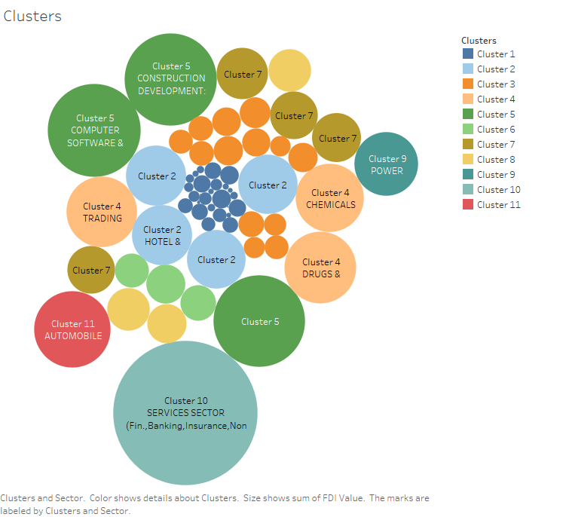
Specific Clusters Present in the Data

Slide 14
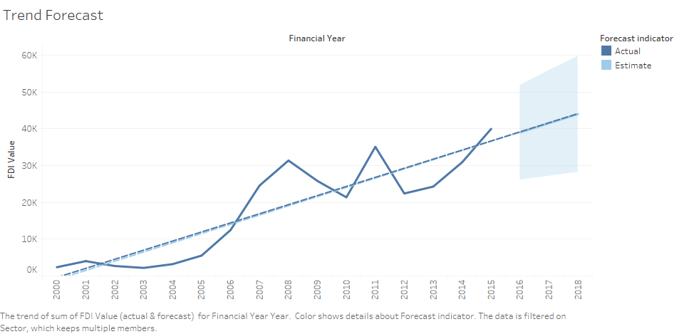
Forecast for the Trend of the Following Year

Slide 15
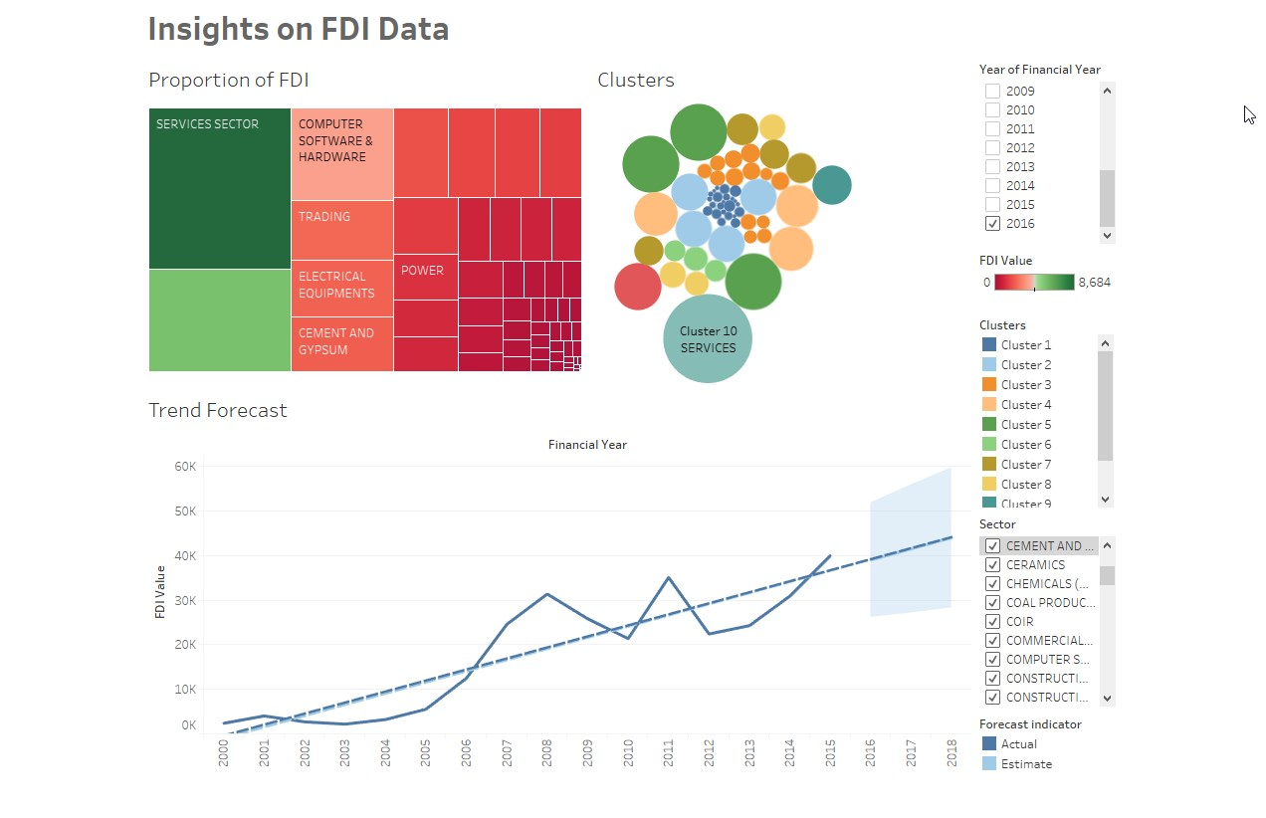
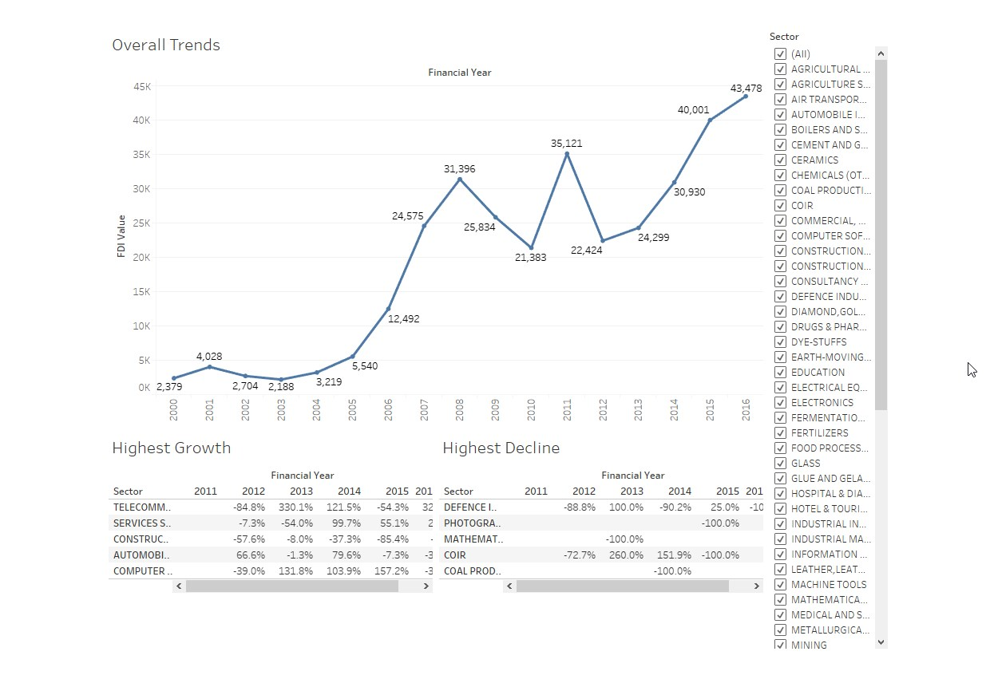
Dashboard

Slide 16
Thank You !
…

Slide 17
Video Presentation Link - :
YouTube Link - :
https://youtu.be/NORCo_46ZoY
Google Drive Link - :
https://drive.google.com/file/d/1pRZoeg3Vw3BfLNFaIFFR9-NyiemhqSQF/view?usp=sharing

